Slide 1

Using Parallel Processing for Electricity Price Forecasting
Petar Miladinov 196038

Slide 2

Introduction
Electricity price forecasting is crucial for guiding decisions in the energy sector. It provides insights into future electricity prices, enabling market participants to optimize resource allocation, manage risk, and make informed trading and investment choices. Accurate forecasting assists in minimizing operational costs, enhancing grid stability, and promoting efficient utilization of resources.
Accurate forecasting in various domains, including electricity prices, presents inherent complexities and challenges. The dynamic nature of factors influencing forecasts, such as market conditions, technological advancements, and regulatory changes, contributes to the intricacies of the process. Accurate forecasting in various domains, including electricity prices, presents inherent complexities and challenges..
Parallel processing is a computational technique that involves breaking down complex tasks into smaller subtasks, which are then executed simultaneously by multiple processing units. This approach aims to enhance both accuracy and efficiency by leveraging the combined computational power of these units. By distributing the workload, parallel processing reduces the time needed for complex computations, resulting in faster results. Additionally, the collaborative processing enables intricate relationships within data to be captured more effectively, leading to improved accuracy in predictions and analyses.

Slide 3
Research objectives
Exploring the capabilities of implementing parallel processing techniques.
Observing and finding solutions in the field of accuracy and computational efficiency.
Potential solution ensemble approach.

Slide 4
Methodology Overview
Sequential Processing using Keras:
Keras is a deep learning library that facilitates building and training neural networks.
Sequential models in Keras involve stacking layers one after the other.
Working principle: Sequential layers process input data sequentially, allowing the model to learn complex patterns over time.
Suitable for capturing temporal dependencies in time-series data like electricity prices.
Parallel Processing using XGBoost:
XGBoost (Extreme Gradient Boosting) is a popular gradient boosting algorithm.
Working principle: Each core/thread handles a portion of the data, building multiple decision trees in parallel.
Ideal for capturing complex relationships in datasets through ensemble learning.
Random Forest Regressor with n Jobs:
Random Forest is an ensemble learning method that creates multiple decision trees.
Parallel processing with 'n' jobs involves dividing the dataset into segments and processing them concurrently.
Working principle: Each job independently constructs a decision tree on its dataset segment.
Allows the model to efficiently handle large datasets and capture diverse patterns.
4.Ensemble of all 3

Slide 5
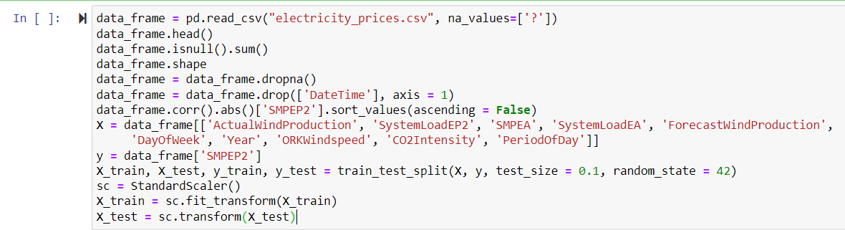
Data Collection and Preprocessing

Slide 6
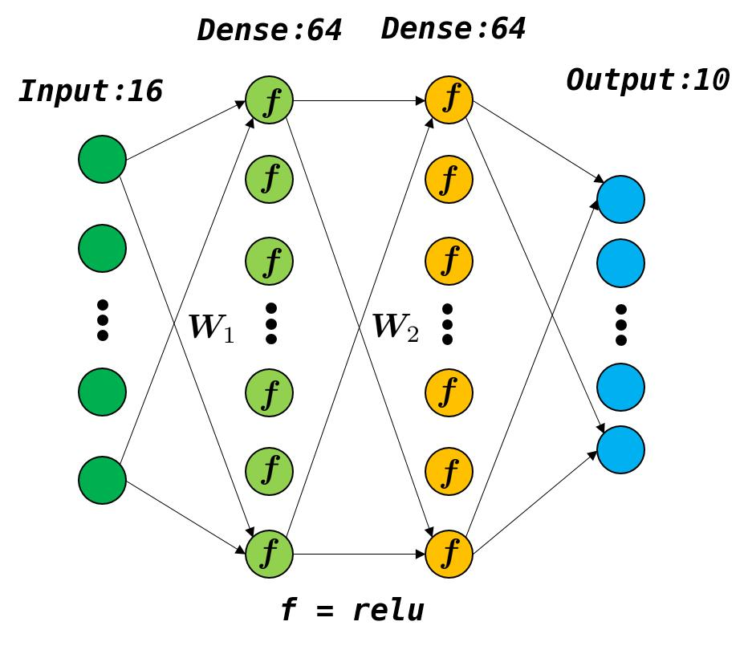
Sequential Processing with Keras
This Photo by Unknown Author is licensed under CC BY-SA

Slide 7
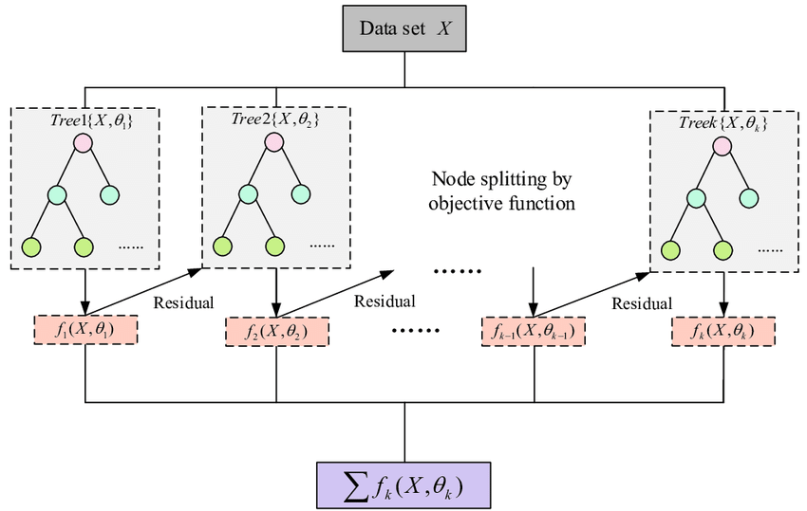
Parallel Processing using XGBoost

Slide 8
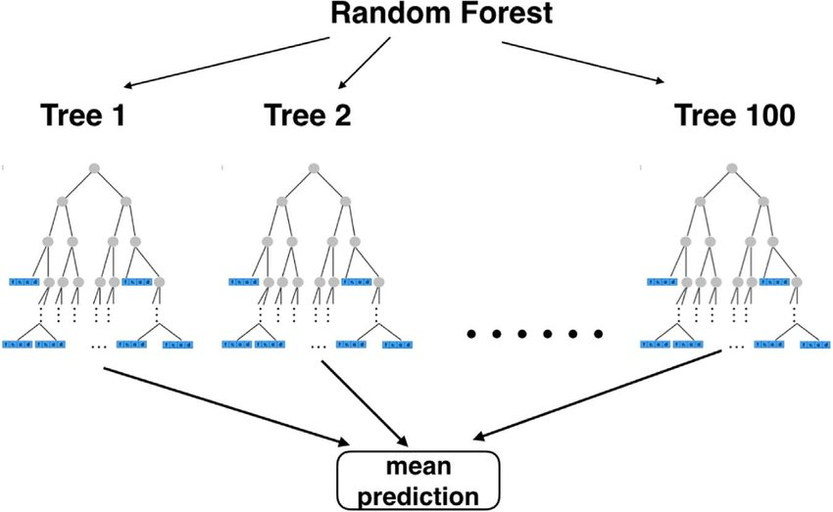
Random Forest Regressor with n Jobs

Slide 9
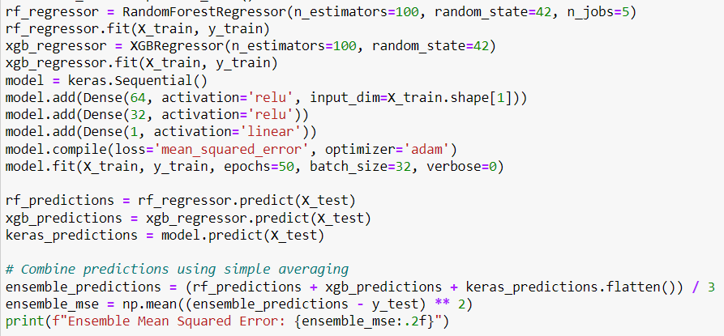
Ensemble Approach

Slide 10
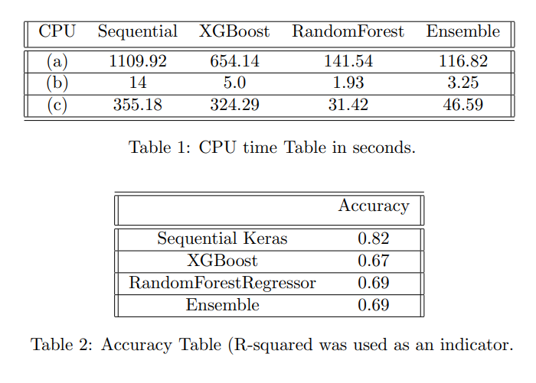
Result and Finding

Slide 11
Future Research
The implications of the research are twofold. Firstly, the findings emphasize the importance of striking a balance between rapid computation and precise forecasting. Secondly, the study highlights the potential for future research to integrate parallel processing methodologies to create hybrid models that deliver both speed and accuracy.

Slide 12
Conclusion
The study's contributions lie in its exploration of parallel processing techniques for enhancing electricity price forecasting. By investigating Keras sequential, XGBoost, and RandomForestRegressor with n jobs, the research provides insights into their impact on accuracy and computational efficiency. The study bridges the gap between computational speed and prediction accuracy, offering an understanding of the trade-off that energy market stakeholders need to navigate.
Reiterating the significance of parallel processing, it stands as a powerful tool that addresses the inherent challenges in electricity price forecasting. By leveraging multiple processing units, parallel processing efficiently captures intricate relationships in data, resulting in improved accuracy.

Slide 13
THANK YOU FOR YOUR TIME ! ☺

